Slide 1
Creating An instructor proposal
By Harvey Hedden

Slide 2
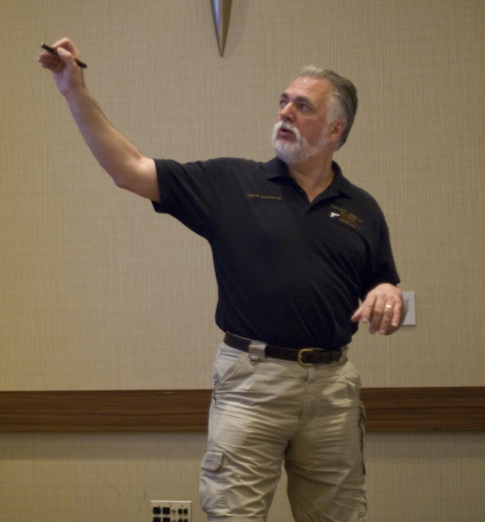
Creating a course proposal
ILEETA encourages everyone to submit course proposals
What are you doing particularly well
Innovative subject areas
Members whose proposals are selected receive a conference tuition waiver but no other compensation

Slide 3
Proposal guidelines
Subject must be instructor oriented
What will they take back to their agency?
No infomercials

Slide 4
General subject areas
Armorer
Live Fire
Officer Safety
Use of Force
Instructor Development
Firearms Training
Management
Active Shooter
Community Relations
Health/Wellness
Special Topics

Slide 5
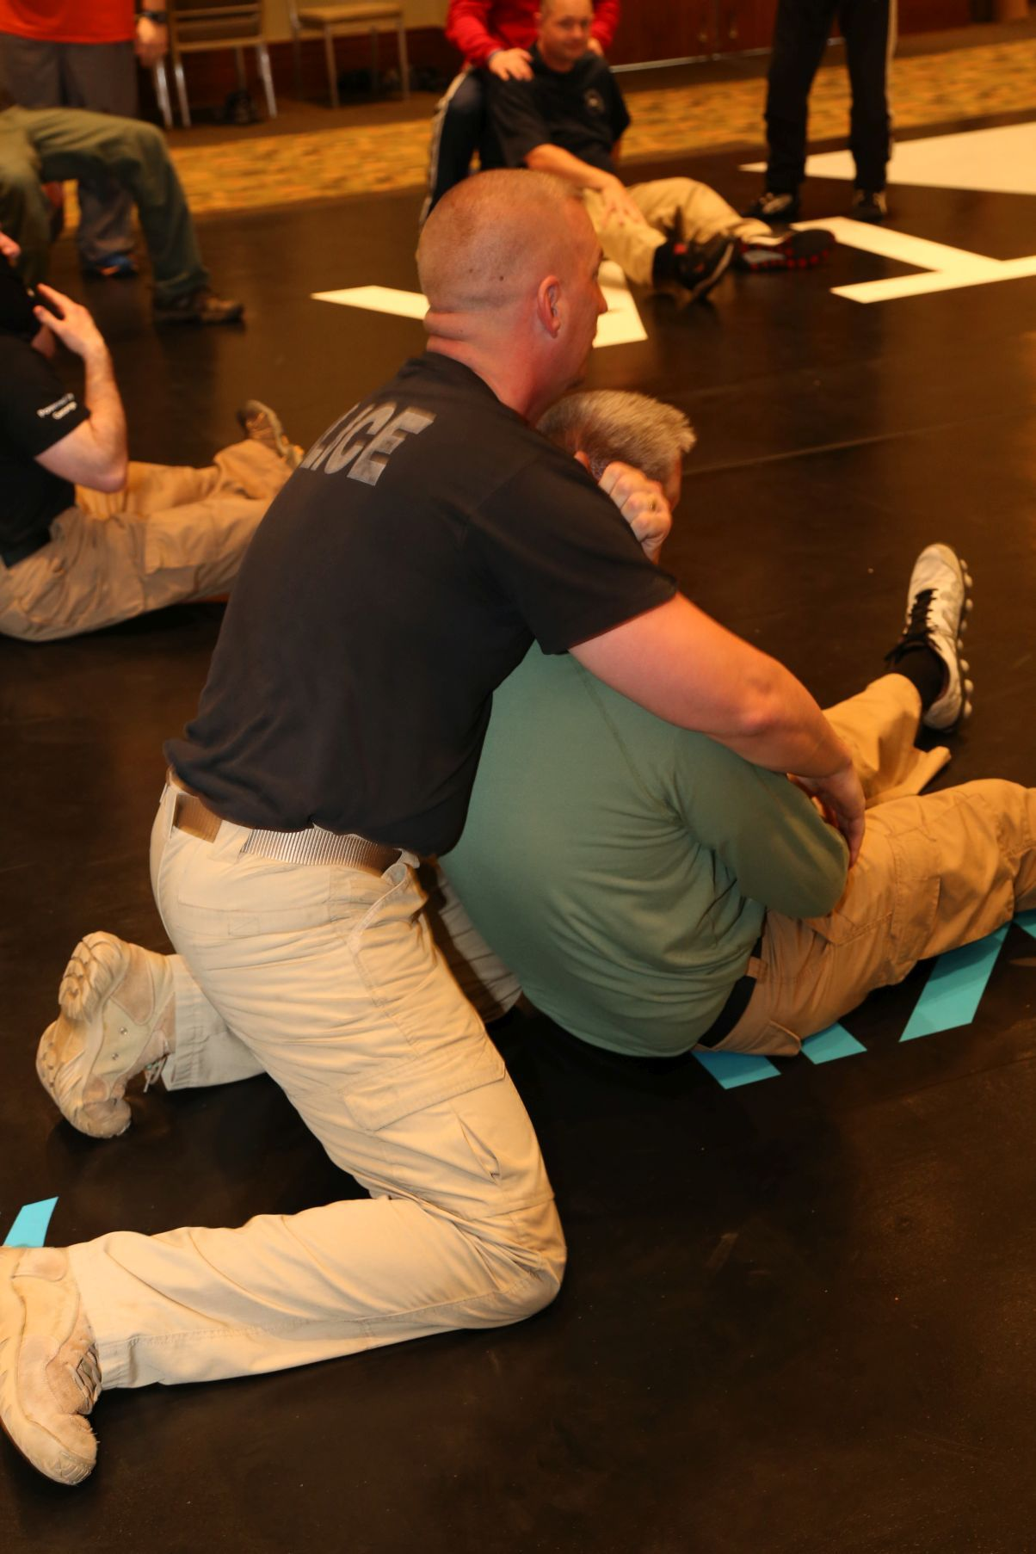
Defensive tactics
Skill levels may vary
Pre-requisite courses/skills
Safety is critical – triple check
Warm ups/Mats prevent injury
Adequate Instructor/Safety Monitor/Student Ratio

Slide 6
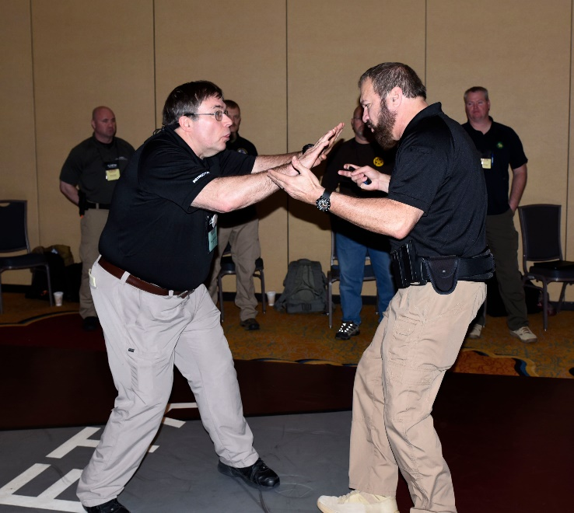
Factors that influence selection
Anticipated demand for this type of instruction
Unusual facility requirements/setup time/costs to ILEETA
Cannot serve at least 15 attendees (20+ preferred)
Schedule conflicts/availability

Slide 7
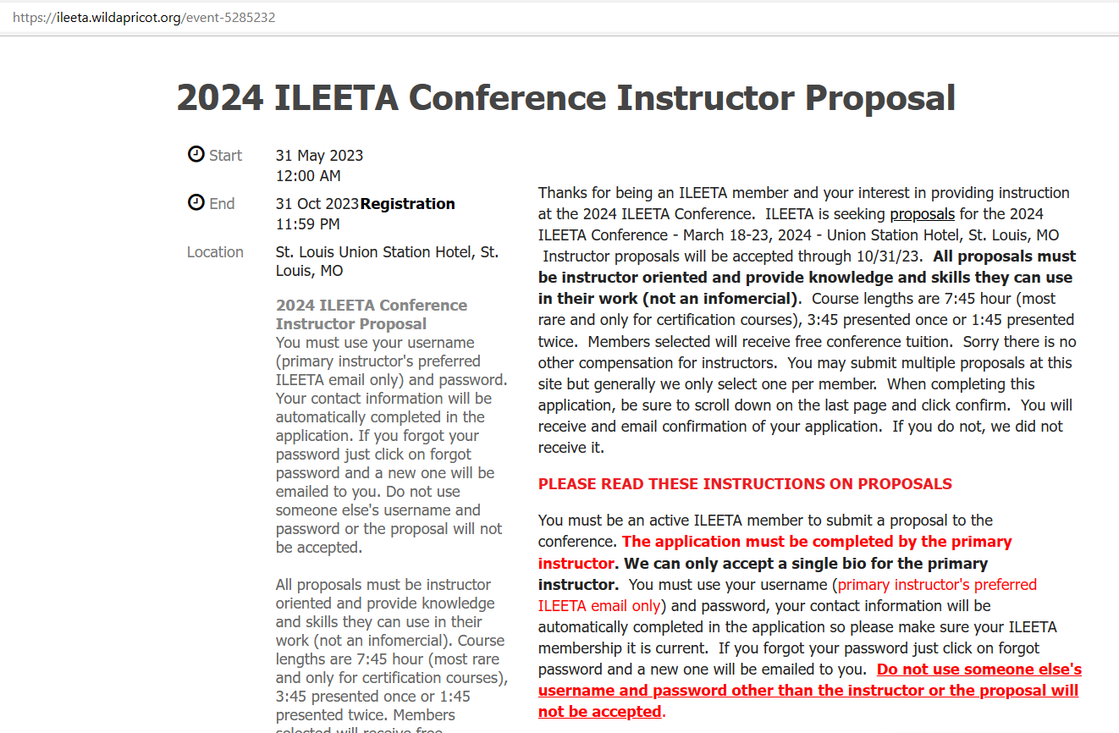
Instructor proposal form
Proposal landing page contains important information – please read this page.

Slide 8
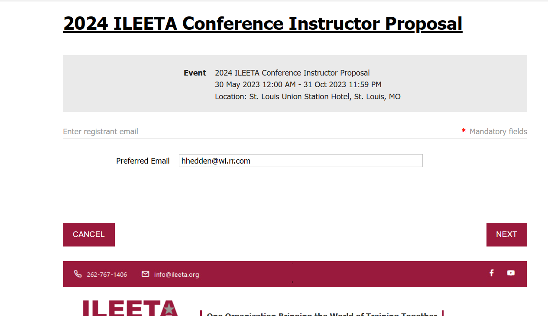
Instructor proposal form
Must use username and password to login to the proposal form
Username and password must match instructor name

Slide 9
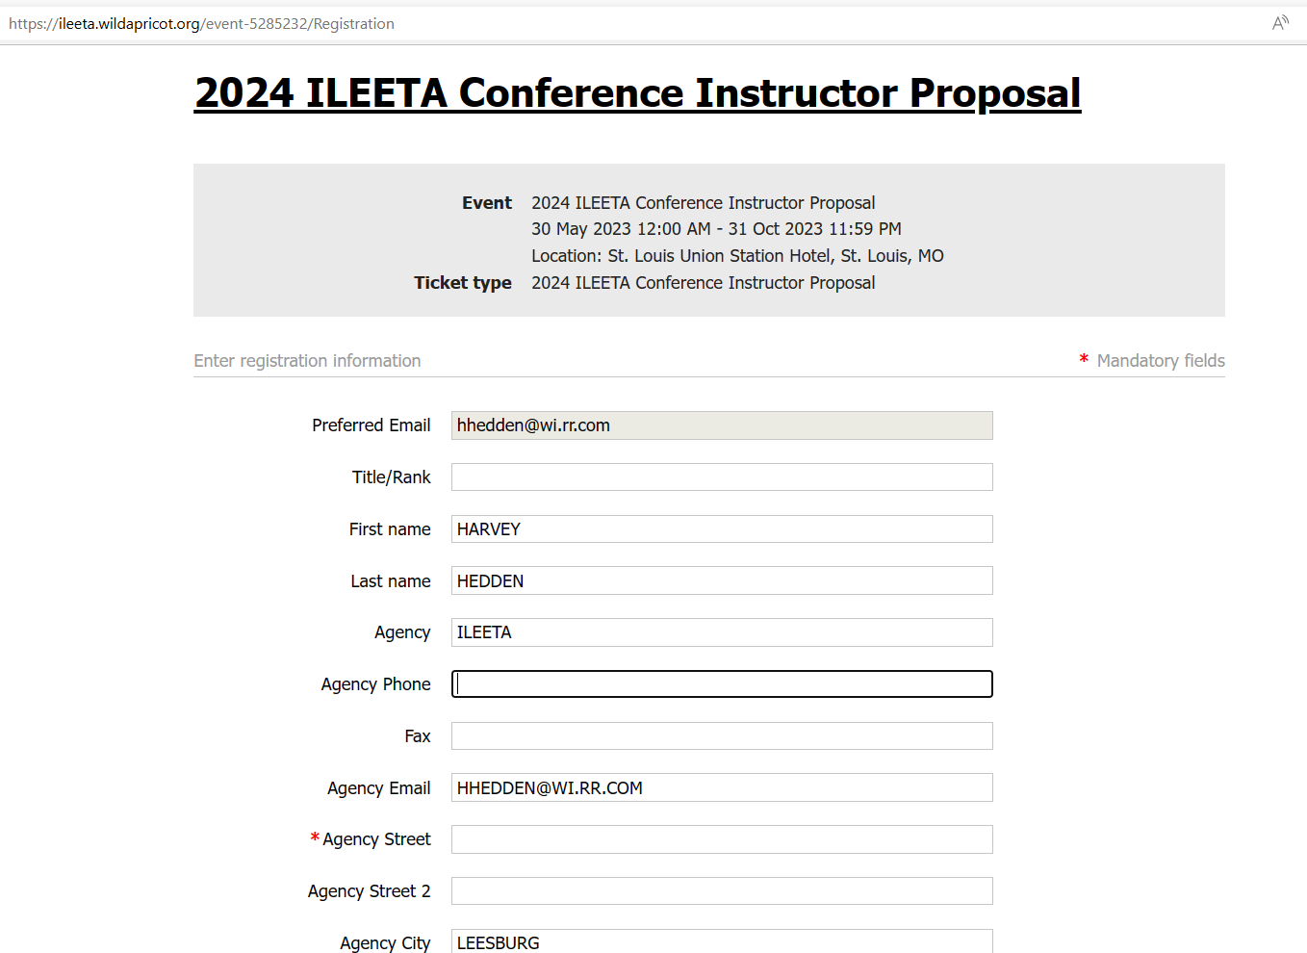
Instructor info
Your personal data is auto filled into the form
Check to see that this info is current – No All CAPS in any field

Slide 10
Course TITLE
Should tell the attendee what the course is about so they want to read more about it
65 characters maximum
Good title influences attendance
“The sizzle sells the steak”

Slide 11
Course LENGTH
The most popular courses are the shorter ones
Attendees want to get as much variety out of their conference week as they can
2 hour (1 hour & 45 minutes) blocks are repeated (you will present them twice)
8 hour blocks generally reserved for certification courses

Slide 12
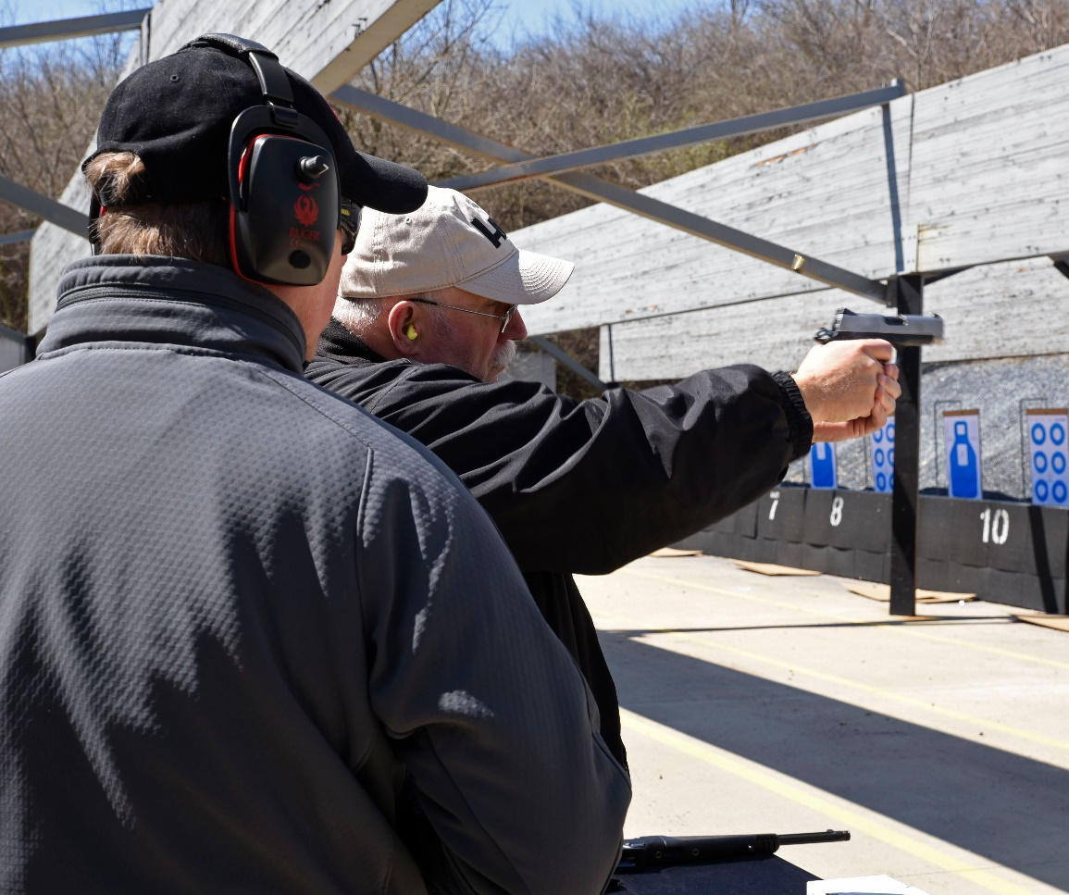
Course PREREQUISITES
All attendees are trainers and educators
Our purpose is to train the trainer and not the end user
It is OK to require that the attendee be an instructor in the discipline you are teaching, e.g. live fire class attendee should be a firearms instructor. If LE only state why in comments (last field)
Equipment needed – include in comment section

Slide 13
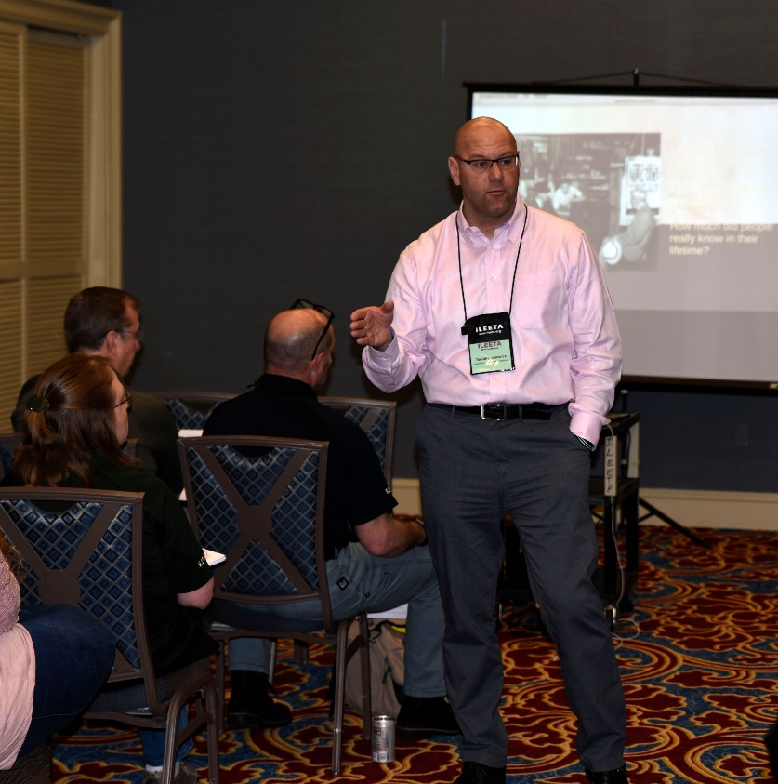
CERTIFICATION Course
Why does this training need to be a certification?
What will the person who completes the course be able to do that they could not if they just attended the instruction?
Who/What administers the certification?
Will an attendee be willing to spend 20% of their conference on this subject?

Slide 14
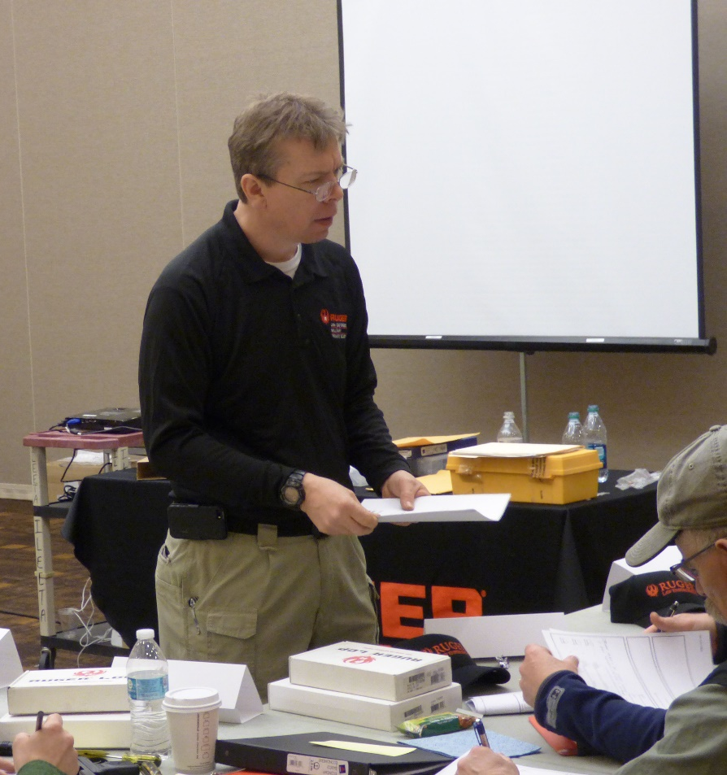
CERTIFICATION Course
Certification requires attendee demonstrate knowledge and/or competence
Certification usually requires recertification at some time – what is that period?
Course fee is only intended to help cover cost of materials and certification

Slide 15
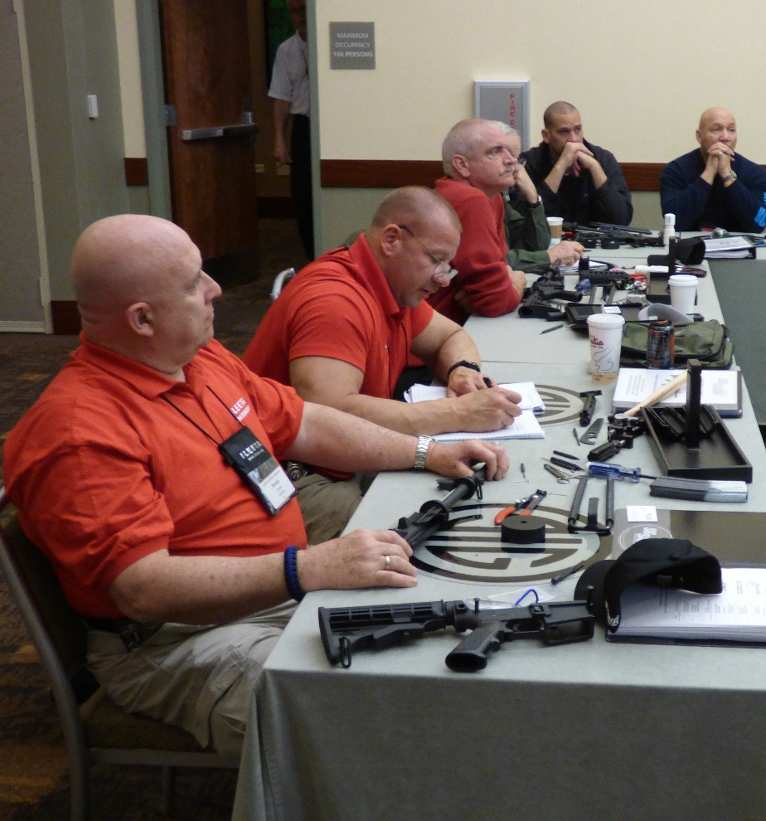
CERTIFICATION Course
Attendees pre-register for certification courses
ILEETA can take online registrations or you may designate a point of contact for the course
If ILEETA takes registrations we will send you a spreadsheet of your attendees several weeks in advance of the conference so that you may contact them and know how many you may expect

Slide 16
Pre-conference certification coursework
Registered attendees are sent materials that are to be completed prior to the conference class
May include cognitive testing
Saves valuable conference hours

Slide 17
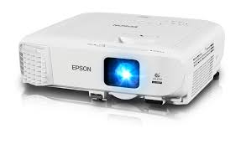
CLASSROOM AND EQUIPMENT
We provide projectors, cart, speakers, screen for each classroom
Please bring your own laptop
We have available flip charts and markers upon request
Use of public address is very limited because of adjacent classes
WiFi also limited, consider bringing your smartphone as a hot spot

Slide 18
SECONDARY INSTRUCTOR
Generally for safety in hands on classes such as live fire and DT
We anticipate the instructor should be able to conduct a lecture class without support
Do not look at this as an opportunity to get your buddy a tuition waiver

Slide 19
Course OBJECTIVES AND SYNOPSIS
This information is intended to aid the review committee is evaluating the proposal and is not distributed to attendees

Slide 20
Course description
Goals and objectives, what will attendees take from the course
20% of proposals fail to follow the directions and must be corrected
600 characters with spaces use MS-Word Review to count
Spell check your description
Single paragraph – no bullet points or lists
No all CAPS in any data field in this proposal including your personal data

Slide 21
Instructor bio
500 characters with spaces use MS-Word Review to count
Spell check your bio
Single paragraph – no bullet points or lists
Third person
Why qualified to teach this subject
Accomplishments, current responsibilities

Slide 22
References
This information aids the review committee in evaluating the course proposal
References, courses taught for other groups, books, articles, extras the attendees will receive
Personal references

Slide 23
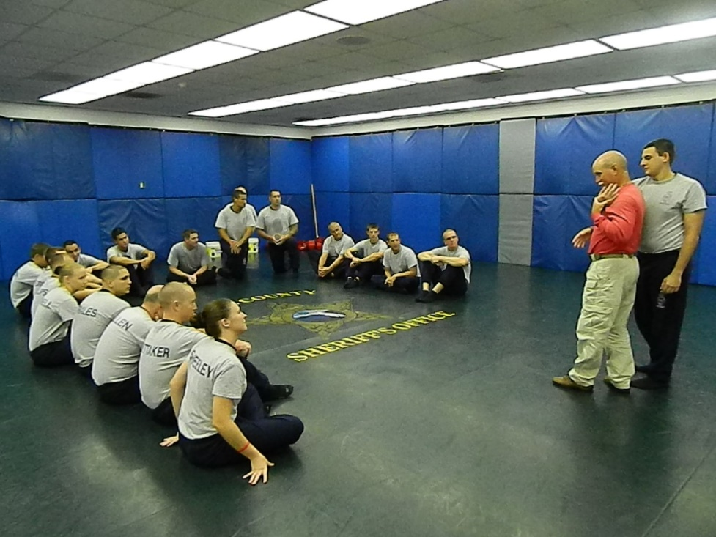
HANDOUT MATERIALS
Positively influences proposal selection
Helps the attendee when they return to work
Aids in notetaking
ILEETA will have no on-site duplication
ILEETA will include digital handouts submitted in a conference dropbox file

Slide 24
COMMENTS SECTION
Any information that may be valuable to the review of the proposal
May include links but do not send attachments
Note any unusual course requirements, availability issues during the conference week

Slide 25
Proposal review
If you do not click confirm your proposal will not be submitted

Slide 26
If your proposal has been submitted you will see this screen

Slide 27
UpoN SUBMISSION
Once you have submitted your proposal, you should receive an automated confirmation email within 24 hours
Proposal selection will be completed and notifications made by December 1

Slide 28
You have been selected
Make sure you can still attend
Get it together
Digital handouts
Contact with me by e-mail/phone
If you know you must cancel let us know ASAP

Slide 29
Questions? NEED HELP?
Harveyh@ileeta.org

